Slide 1
Image Processing

Slide 2
Overview
Image Representation
What is an image?
Sampling and Reconstruction
Key steps in image processing

Slide 3
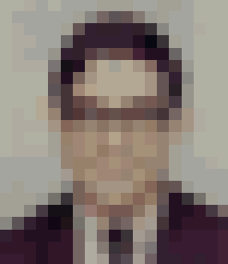
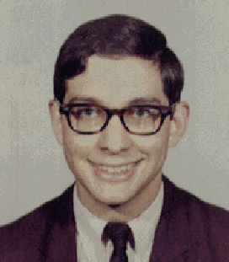
What is an Image?
An image is a 2D rectilinear array of pixels
Continuous image
Digital image

Slide 4

What is an Image?
An image is a 2D rectilinear array of pixels
Continuous image
Digital image

Slide 5
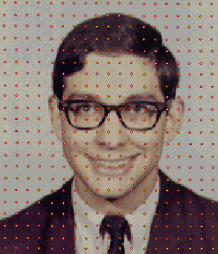
What is an Image?
An image is a 2D rectilinear array of pixels
Continuous image
Digital image
A pixel is a sample, not a little square!!

Slide 6
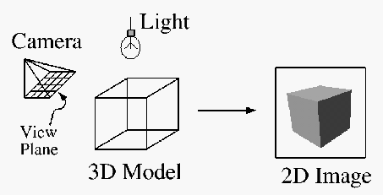
Image Acquisition
Pixels are samples from continuous function
Photoreceptors in eye
CCD cells in digital camera
Rays in virtual camera

Slide 7
Quantization
Artifact due to limited intensity resolution
Frame buffers have limited number of bits per pixel
Physical devices have limited dynamic range
255
150
75
0
255
150
75
0
255
150
75
0
255
150
75
0
255
150
75
0
255
150
75
0
255
150
75
0
255
150
75
0
255
150
75
0
255
150
75
0
255
150
75
0
255
150
75
0
255
150
75
0
Blue channel
255
150
75
0
255
150
75
0
Green channel
Red channel

Slide 8
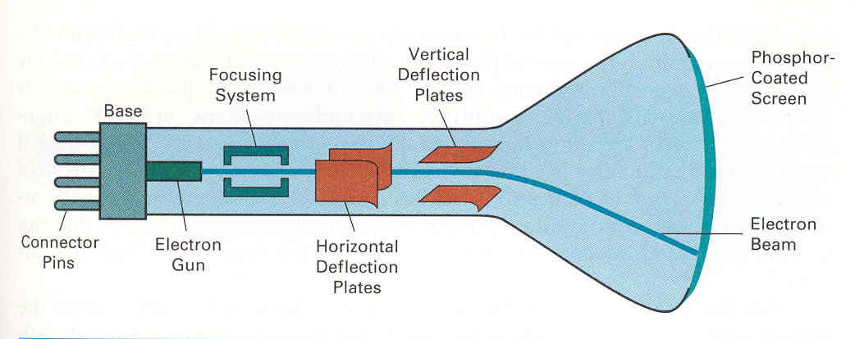
Image Display
Re-create continuous function from samples
Example: cathode ray tube
Image is reconstructed by displaying pixels with finite area (Gaussian)

Slide 9
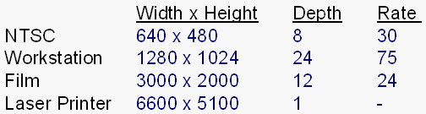
Image Resolution
Intensity resolution
Each pixel has only “Depth” bits for colors/intensities
Spatial resolution
Image has only “Width” x “Height” pixels
Temporal resolution
Monitor refreshes images at only “Rate” Hz

Slide 10
Overview
Image Representation
What is an image?
Sampling and Reconstruction
Key steps in image processing

Slide 11
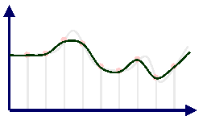
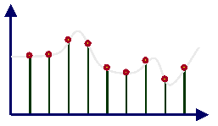
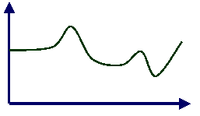
Sampling and Reconstruction
Sampling
Reconstruction

Slide 12
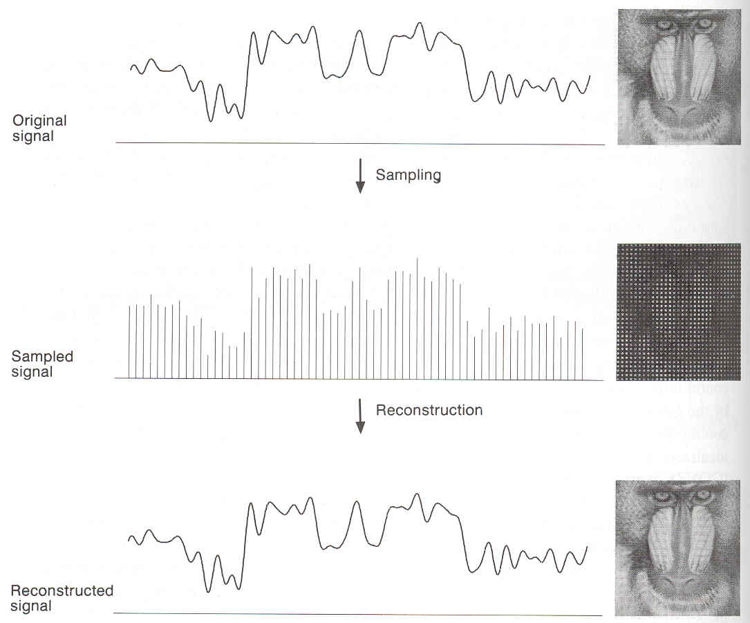
Sampling and Reconstruction

Slide 13
Image Processing
Filtering
Blur
Detect edge
Warping
Scale
Rotate
Warps
Pixel operations
Add luminance
Add contrast

Slide 14
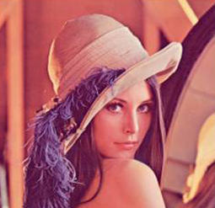
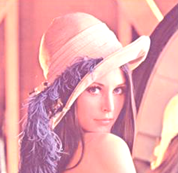
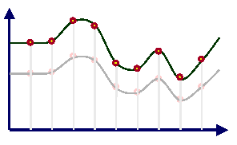
Adjusting Brightness
Simply scale pixel components
Must clamp to range (e.g., 0 to 255)
Original
Brighter

Slide 15
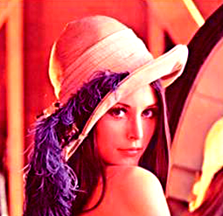
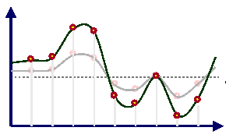
Adjusting Contrast
Compute mean luminance L for all pixels
Luminance = 0.30*r + 0.59*g + 0.11*b
Scale deviation from L for each pixel component
Must clamp to range (e.g. 0 to 255)
L
Original
Contrast

Slide 16
Image Processing
Filtering
Blur
Detect edge
Warping
Scale
Rotate
Warps
Pixel operations
Add luminance
Add contrast

Slide 17
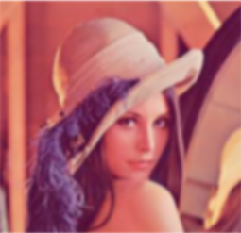
Adjusting Blurriness
Convolve with a filter whose entries sum to one
Each pixel becomes a weighted average of its neighbors
Original
Blur

Slide 18
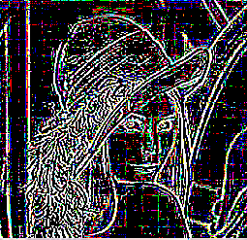
Edge Detection
Convolve with a filter that finds differences between neighbor pixels
Original
Edge Detection

Slide 19
Image Processing
Filtering
Blur
Detect edge
Warping
Scale
Rotate
Warps
Pixel operations
Add luminance
Add contrast

Slide 20
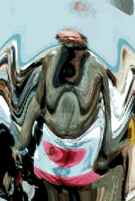
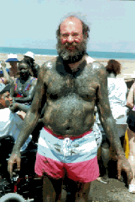
Image Warping
Move pixels of image
Mapping
Resampling
Warp
Source Image
Destination Image

Slide 21
Overview
Mapping
Forward
Reverse
Resampling
Point sampling
Triangle filter
Gaussian filter

Slide 22
Mapping
Define transformation
Describe the destination (x, y) for every location (u, v) in the source (or vice-versa, if invertible)
v
y
u
x

Slide 23
Example Mappings
Scale by factor :
x = factor * u
y = factor * v
v
y
Scale
0.8
u
x

Slide 24
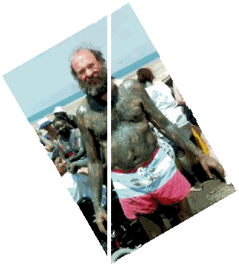
Example Mappings
Rotate by θ degrees:
x = u cos θ – v sin θ
y = u sin θ + v cos θ
y
v
Rotate
30
u
x

Slide 25
Example Mappings
Shear in X by factor :
x = u + factor * v
y = v
Shear in Y by factor :
x = u
y = v + factor * u
v
y
Shear X
1.3
u
x
v
y
Shear Y
1.3
u
x

Slide 26
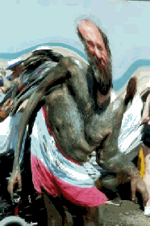

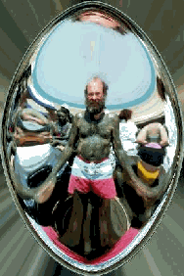
Other Mappings
Any function of u and v :
x = f_{x}(u, v)
y = f_{y}(u, v)
Fish-eye
Swirl
Rain

Slide 27
Image Warping Implementation I
Forward mapping :
for(int u=0; u<umax; u++) {
for(int v=0; v<vmax; v++) {
float x = f_{x}(u,v);
float y = f_{y}(u,v);
dst(x,y) = src(u,v);
}
}
(u, v)
f
(x, y)
Source Image
Destination Image

Slide 28
Forwarding Mapping
Iterate over source image
y
v
Rotate
-30
u
x

Slide 29
Forwarding Mapping – NOT
Iterate over source image
Many source pixels can map to same destination pixel
y
v
Rotate
-30
u
x

Slide 30
Forwarding Mapping – NOT
Iterate over source image
Some destination pixels may not be covered
Many source pixels can map to same destination pixel
y
v
Rotate
-30
u
x

Slide 31
Image Warping Implementation II
Reverse mapping
for(int x=0; x<xmax; x++) {
for(int y=0; y<ymax; y++) {
float u = f_{x}⁻¹(x,y);
float v = f_{y}⁻¹(x,y);
dst(x,y) = src(u,v);
}
}
(u, v)
f
(x, y)
Source Image
Destination Image

Slide 32
Reverse Mapping
Iterate over destination image
Must resample source
May oversample, but much simpler!
y
v
Rotate
-30
u
x

Slide 33
Resampling
Evaluate source image at arbitrary (u, v)
(u, v) does not usually have integer coordinates
(u, v)
(x, y)
Source Image
Destination Image

Slide 34
Overview
Mapping
Forward
Reverse
Resampling
Point sampling
Triangle filter
Gaussian filter

Slide 35
Point Sampling
Take value at closest pixel
int iu = trunc(u+0.5);
int iv = trunc(v+0.5);
dst(x, y) = src(iu, iv);
This method is simple, but it causes aliasing
v
y
Rotate
-30
Scale
0.5
u
x

Slide 36
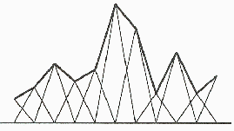
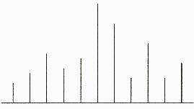
Triangle Filtering
Convolve with triangle filter
Input
Output

Slide 37
Triangle Filtering
Bilinearly interpolate four closest pixels
a = linear interpolation of src(u₁, v₂) and src(u₂, v₂)
b = linear interpolation of src(u₁, v₁) and src(u₂, v₁)
dst(x, y) = linear interpolation of “a” and “b”
a
(u₁, v₂)
(u₂, v₂)
(u, v)
(u₁, v₁)
(u₂, v₁)
b

Slide 38
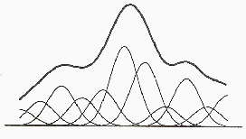
Gaussian Filtering
Convolve with Gaussian filter
Input
Output
Width of Gaussian kernel affects bluriness

Slide 39
Gaussian Filtering
Compute weighted sum of pixel neighborhood :
Weights are normalized values of Gaussian function
(u, v)

Slide 40
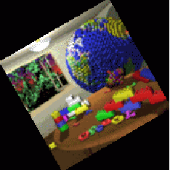


Filtering Methods Comparison
Trade-offs
Aliasing versus blurring
Computation speed
Point
Bilinear
Gaussian

Slide 41
Image Warping Implementation III
Reverse mapping
for(int x=0; x<xmax; x++) {
for(int y=0; y<ymax; y++) {
float u = f_{x}⁻¹(x,y);
float v = f_{y}⁻¹(x,y);
dst(x,y) = resample_src(u,v,w);
}
}
(u, v)
f
(x, y)
Source Image
Destination Image

Slide 42
Image Warping Implementation III
Reverse mapping
for(int x=0; x<xmax; x++) {
for(int y=0; y<ymax; y++) {
float u = f_{x}⁻¹(x,y);
float v = f_{y}⁻¹(x,y);
dst(x,y) = resample_src(u,v,w);
}
}
(u, v)
f
(x, y)
w
Source Image
Destination Image

Slide 43
Example: Scale
Scale (src, dst, sx, sy) :
float w ≈ max(1/sx, 1/sy)
for(int x=0; x<xmax; x++) {
for(int y=0; y<ymax; y++) {
float u = x/sx ;
float v = y/sy;
dst(x,y) = resample_src(u,v,w);
}
}
v
y
(u, v)
Scale
0.5
(x, y)
u
x

Slide 44
Example: Rotate
Rotate (src, dst, theta)
for(int x=0; x<xmax; x++) {
for(int y=0; y<ymax; y++) {
float u = x*cos(-θ)-y*sin(-θ)
float v = x*sin(-θ)+y*cos(-θ)
dst(x,y) = resample_src(u,v,w);
}
}
y
v
(u, v)
(x, y)
Rotate
30
u
x

Slide 45
Example: Fun
Swirl (src, dst, theta)
for(int x=0; x<xmax; x++) {
for(int y=0; y<ymax; y++) {
float u = rot(dist(x,xcenter)*θ)
float v = rot(dist(y,ycenter)*θ)
dst(x,y) = resample_src(u,v,w);
}
}
v
(u, v)
y
(x, y)
Swirl
45
u
x

